Slide 1
Calculator Application

Slide 2
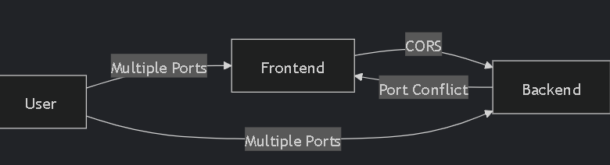
Problem Definition:
Port Management: Frontend (3001) and backend (3000) require different ports
Deployment Complexity: Packaging two services as one executable
Security Risks: Unsafe eval() usage in math calculations

Slide 3
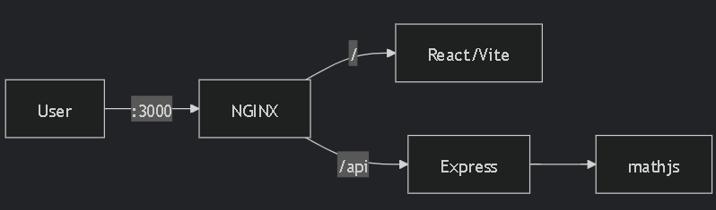
Technical Approach:
Reverse Proxy: Nginx(or traefik):
First run nginx on same port as our node.js app, we then configure nginx to route the frontend requests
To the port for our node.js app and the route for
Backend requests also to the same node.js app
Key Components:
Reverse Proxy: NGINX unifies ports (3000)
Electron Packaging: Single EXE with:
Embedded Node.js
Chromium renderer
Auto-update capability

Slide 4
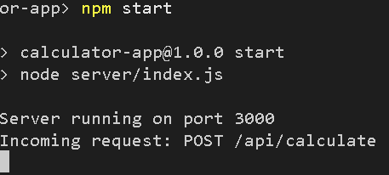

Achieved Solution:
Results: ✅ Single-Port Access: 3000 for all traffic ✅ One-Click EXE: 50MB standalone installer ✅ Zero CORS: NGINX handles routing ✅ Secure: No eval() usage

